Slide 1

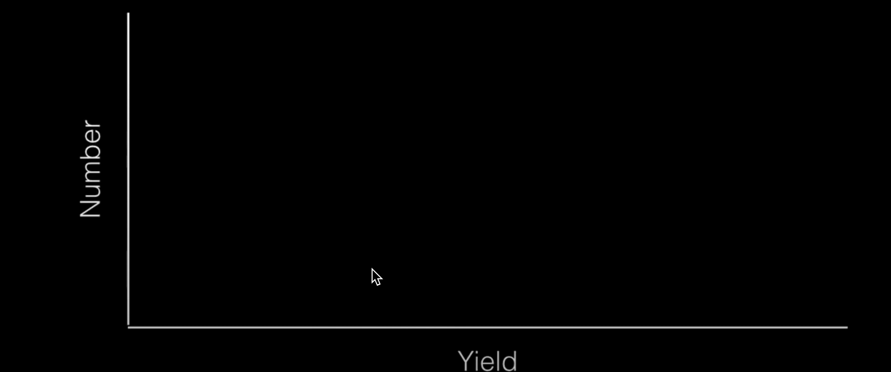
Beer has advanced statistics: the Student’s - test
William Gosset was a brewer at Guiness, and Oxford Chemistry and Mathematics graduate
At Guinness he needed to assess quality control statistically, e.g. as the yeast content the same in each batch and equal to μ0 ?
Is the barley grown in two different fields of the same farmer of the same quality?
He came up with a statistical test to do this, but published under the name “Student” with Karl Pearson and R. A. Fischer, because he worked at Guinness.
A
B
W.S. Gosset aka ‘the Student’
13 June 1876 – 16 October 1937
Dr Antonia Mey — Data-driven Chemistry— Session 6
Notes:
For Gosset the fundamental new statistical problem was that with such small samples it was unclear how well the standard deviation, s, of the sample reflected the population standard deviation. For example, one farmer might grow four plots of barley but find quite different results in the four plots, while another farmer might grow four plots of a different barley and also get quite different results in his four plots. That made it very difficult to tell if there was any significant difference between the two barleys. There was no way to assign probabilities accurately to observed differences, to distinguish “real” differences from random variation. The contrast between the two types of barley might have been clearer if each farmer had been able to plant more plots, but that was financially not practical.
Gosset worked with Karl Pearson on this issue during a sabbatical.

Slide 2
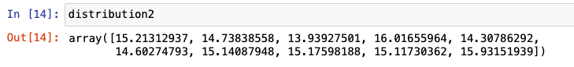
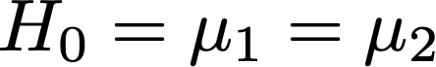
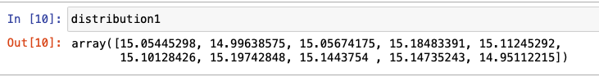
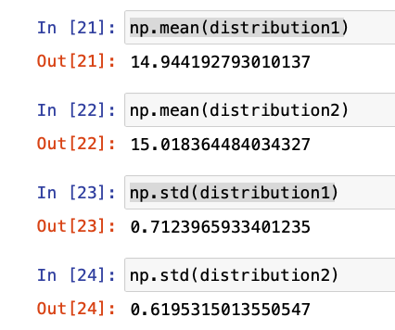
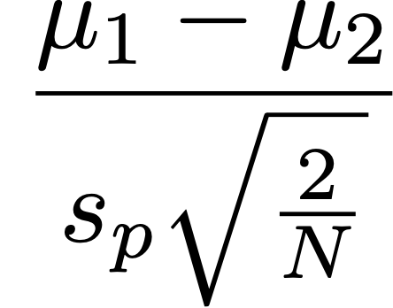
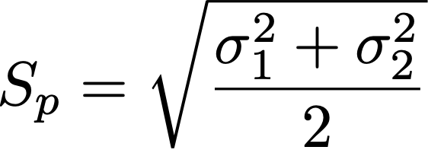
The Null hypothesis and t-value
The null hypothesis:
The difference in means between two datasets is 0.
Signal
Difference between group means
t-value
=
=
=
Noise
Variability of groups
Then we get a t-value? What do we do with it?
Notes:
When you perform a t-test with Python, you will get a p-value returned, giving you the probability of how likely is it to see this result by chance. The p-value is a proportion: if your p-value is 0.05, that means that 5% of the time you would see a test statistic at least as extreme as the one you found if the null hypothesis was true.

Slide 3
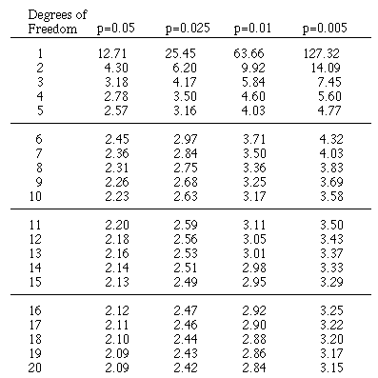
Looking at a p-value table
Alpha-level
Is our t- value higher than the value found in the table?
What the Python library will give us is a p-value, this means we don’t actually have to go and look at these tables!
So depending on the alpha level we are using, we can accept or reject the Null hypothesis immediately.
The trick with all of these is selecting the right statistical test for your data!
Degrees of freedom = (N1+N2-2)
Notes:
If we were to do this sample 100 times then we 5 times we would accept the null hypothesis and 95 times we would reject it.

